Slide 1
Implementation and Impact of Lean
Redesigns in Primary Care
June 6, 2017
Lean Healthcare Research Symposium
Lean Transformation in Health Care Summit
Dorothy Hung, Ph.D., M.A., M.P..H.
Palo Alto Medical Foundation Research Institute
University of California at San Francisco
Funder: Agency for Healthcare Research and Quality
Accelerating Change & Transformation in Organizations and Networks (ACTION II)

Slide 2
Palo Alto Medical Foundation (PAMF)
Multispecialty, not-for-profit ambulatory care delivery system
Serves over 1 million patients
Operates in 6 counties in San Francisco Bay Area
>900 physicians, 5000 non-MD staff
Majority fee-for-service:
- 70% commercial FFS
- 12% commercial HMO
- 13% Medicare/Medicaid
- 5% Self-pay or Other

Slide 3
Implementation of Lean in Primary Care at PAMF
Systematic spread across all primary care clinics
P
Pilot (Model Line / Cell)
Fremont
Beta test
G
Gamma clinic
Palo Alto
Sunnyvale
Santa Cruz
G
G
G
G
G
G
Mountain View
Dublin
Santa Clara
Redwood City
Los Altos
Los Gatos
G
G
G
G
G
G
G
Scotts Valley
Watsonville
Aptos
Downtown Santa Cruz
Westside
West Valley
Redwood Shores

Slide 4
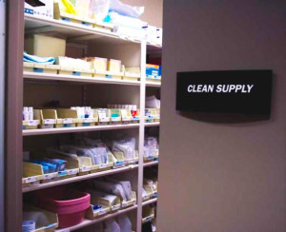
Implementation of Lean Redesigns
Sequence of Lean-based improvements in all clinics
Value Stream Mapping
5S of Work Space
Workflow Redesigns:
Co-location of MD/MA dyads
Daily huddles
Agenda setting
In-basket management
Call Management

Slide 5
Qualitative Data Sources
In-depth interviews (N=113)
- Physicians
- Clinic leaders
Focus Groups (N=11 groups, 3-6 members each)
- Medical Assistants
Observations (N=20)
- Improvement events
- Workflows
In-depth Interviews by Professional Role
 | Interviewed
Frontline Physicians
Family Practitioners | 26
Internists | 19
Pediatricians | 24
Organizational Leaders
Physician Leaders | 21
Operations Leaders | 23
Total | 113

Slide 6
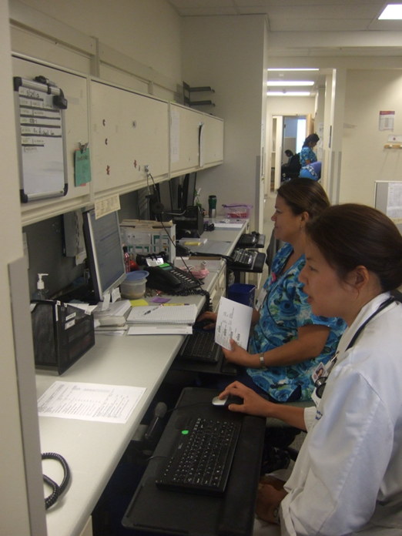
Implementation Measures
Study focused on two aspects of
implementation:
Acceptance – Degree to which those impacted by the Lean change effort viewed the changes as acceptable in principle
Adoption – The reported adoption, attempt to adopt, or conversely, abandonment of Lean redesigns in practice

Slide 7
Outer Setting
Economic pressures and policy changes facilitated acceptance of Lean as a potential solution for primary care.
“Burning platform”
“Hamster health care”
“The burning platform was really our affordability targets and how are we going to weather [this] when we come upon it.” – Clinic Leader
“Just grinding out patients as a primary care doc… it feels like emptying the ocean with a teaspoon. The psyche of being a primary care doctor these days has got to get better…” “It’s hard to be on a treadmill…”
– Physician

Slide 8
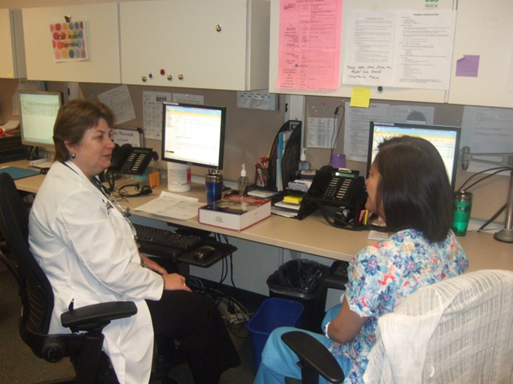
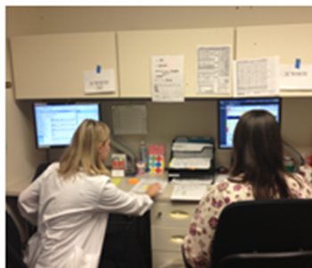
Intervention Characteristics
Co-location affected frontline experiences with Lean redesigns.
Physician-Medical Assistant (MA) dyads sit side-by-side to facilitate communication, patient care workflows.
“It’s really a teachable moment too…we’re finding that the physicians are saying, ‘Oh, you know that patient that had X, Y, and Z…this is what the diagnosis is and this is what it means,’ or ‘Here are some symptoms to look out for.’ So, it’s a really good opportunity for that dyad to have teaching.”
- MA Supervisor

Slide 9
Intervention Characteristics
Challenges to accepting Lean standardization of workflows and care processes.
“You have to say please trust me because if we all do it the same way and we all follow the same rules…then the whole team can perform at an optimum level from the patient service representative, to the doctor and everyone in between, and you not only get back more time, you build a better care, you can see more patients, and you feel better about coming to work.” – Clinical Director

Slide 10
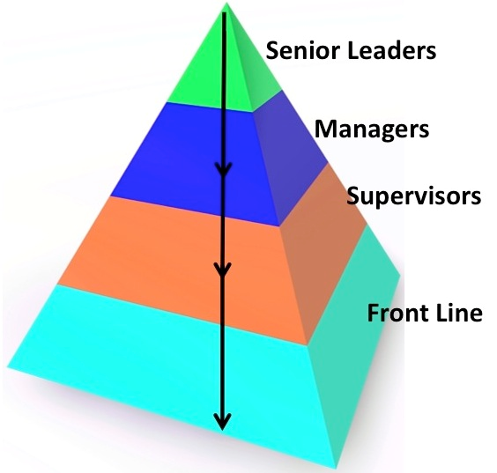
Process of Implementation
“Top-down” vs. “Bottom-up”
Some characterized Lean as a top-down effort led by “higher ups”
- At odds with Lean principle of
“respect for people” doing the
frontline work
Others described this as an “appropriate approach”
- System-wide, complex changes like
Lean may necessitate this style

Slide 11
Process of Implementation
Engaging frontline employees in developing Lean work designs is a critical aspect of “Process.”
“[I think for Lean to be successful] …make sure that the doctors and the staff continue to have a say in what happens. That's always a big concern is that… people are worried things just happen from above and we're losing control.” – Internist
Leads to greater willingness to “try out” Lean redesigns.

Slide 12
Characteristics of Individuals and Teams
Changing work roles and relationships between care team members influenced uptake of redesigns.
Required skillsets and work scope of medical assistants (MAs) as newly designated “Lean Flow Manager”
Physician compliance with redesigns affected team’s ability to adopt the new workflows.

Slide 13
Characteristics of Individuals and Teams
Physician autonomy and adherence to Lean redesigns:
Those most resistant to Lean believed they were “already highly efficient.”
Some were concerned that Lean threatens their autonomy; others acknowledged they still had “authority where it matters” most—in exam room:
“I don't feel like my work has changed so much that I'm not in control. I still decide what I'm doing with my patients. It's just that Lean presents my patients to me in a nicer way so that I can do my work better.” – Physician

Slide 14
Summary
Similarities but also many differences between clinics in successful implementation of Lean redesigns
External environment impacted acceptance of Lean in principle
Market pressures, Patient demand in primary care
Local factors played critical roles in adoption of Lean in practice
Hung DY, Gray CP, Martinez MC, Schmittdiel J, Harrison MI. Acceptance of Lean Redesigns in Primary Care: A Contextual Analysis. Health Care Management Review. 2016 Mar 2. [Epub ahead of print]
Intervention characteristics
Co-location
Process of Implementation
Top-down vs. Bottom-up
Inner setting
Organizational culture
Standardization
Local leadership
Employee engagement
Physician autonomy
Work roles & relationships
Individuals and Teams

Slide 15
Impact of Lean on System Performance
Longitudinal analysis of a range of performance metrics typically used for operational purposes
Performance areas examined:
Workflow Efficiency (“Flow” metrics)
Physician Productivity
Operating Expenses
Clinical Quality
Patient Satisfaction
Physician and Staff Satisfaction

Slide 16
Methods
Data sourced from dashboards, billing, quality reports, Experience of Work, AMGA, and Press-Ganey surveys
Generalized linear mixed models, MD-month unit of observation (N=328 MDs employed consecutively from 2011-2014)
Estimated overall impacts over time using interrupted time series analysis and non-randomized stepped wedge design
Phased implementation of Lean across the system:
Projected metrics (“counterfactual” in the absence of Lean) vs. Observed after Lean redesigns were implemented in all clinics across the system

Slide 17
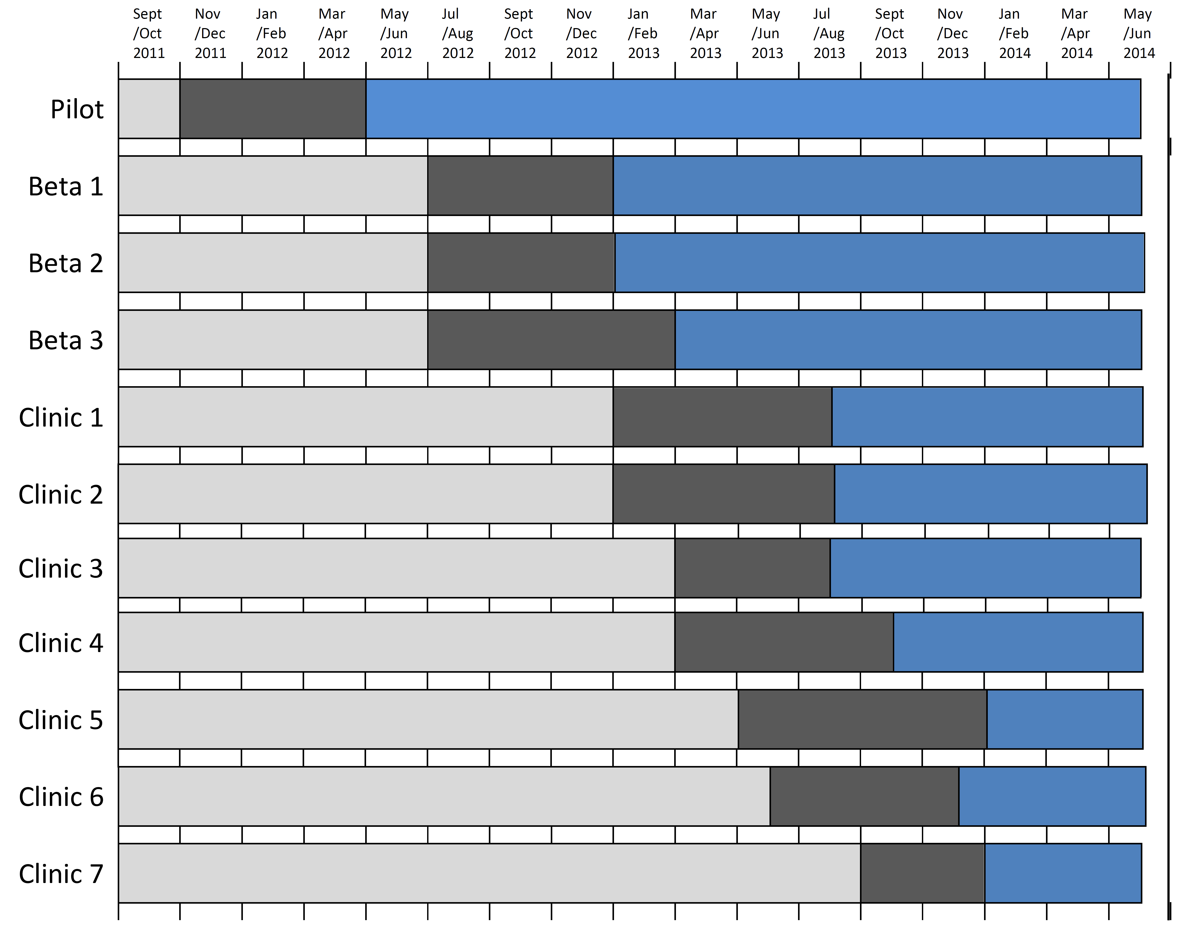
Phased Implementation of Lean Redesigns
Note: All
listed
C
linics
(
except
4
and 7
)
have additional
satellite
clinic
site
s that were included for
analysis
.
Pre
-
Intervention period
Training
/Implementation
Post
-
Intervention period

Slide 18
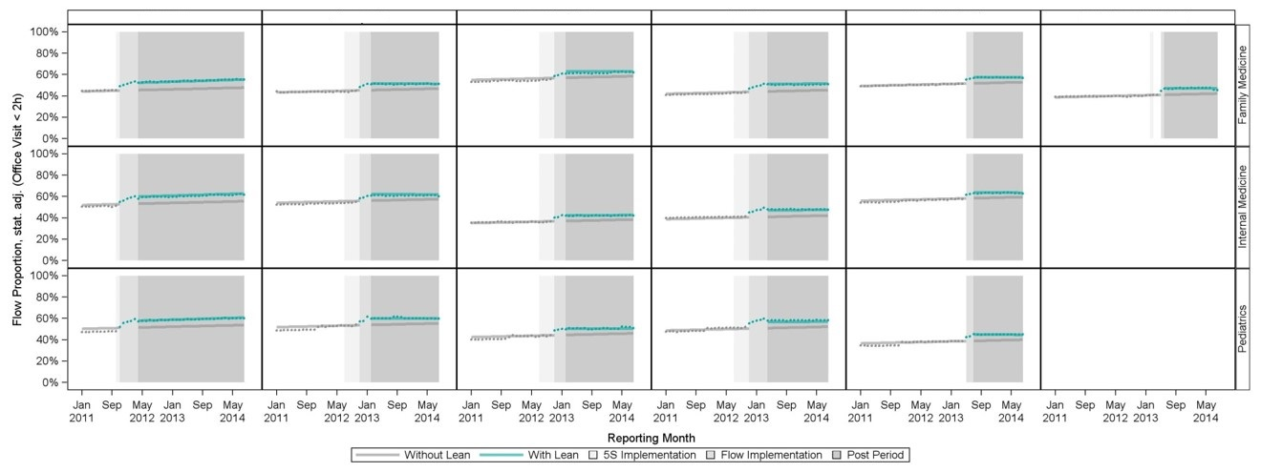
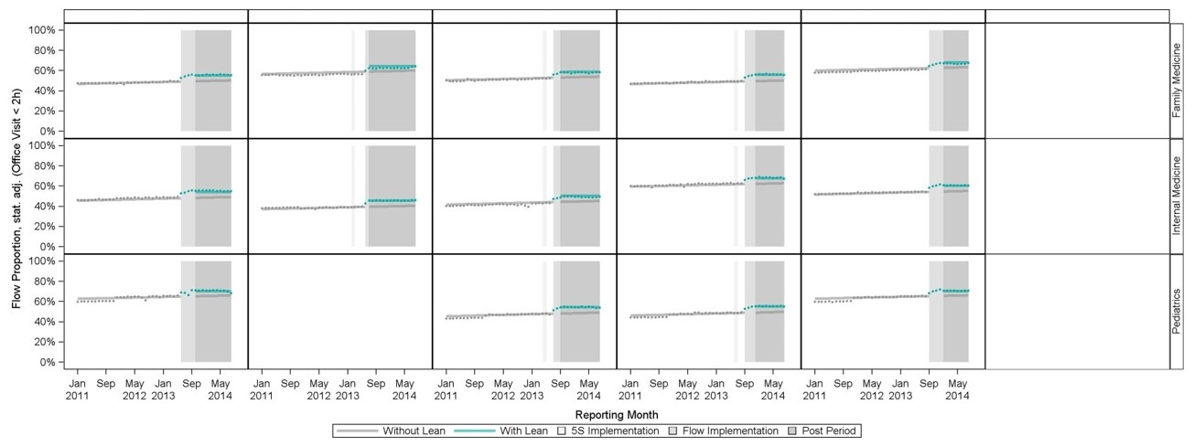
Example: Office Visit Charts Closed < 2 hours
Pilot
Beta 1
Beta 2
Beta 3
Clinic 1
Clinic 2
Clinic 3
Clinic 4
Clinic 5
Clinic 6
Clinic 7

Slide 19
Workflow Efficiency
Flow Metric | Projected Value | Observed Value | Mean Difference (95% bootstrap) | % Change from Baseline
Office Visit Charts < 2h | 51.2% | 56.2% | -5.0% * | 10.0%*
E-messaging < 4h | 79.5% | 77.7% | -1.9% * | -3.4%
Rx Renewal < 4h | 63.4% | 71.4% | -8.0% * | 12.6%*
Telephone Closed < 4h | 57.3% | 62.4% | -5.1% * | 8.9%*
*p<0.05
Flow Metrics
Office visit charts closed within 2 hours
Electronic patient messages responded within 4 hours
Prescription refills renewed within 4 hours
Telephone encounters closed within 4 hours

Slide 20
Physician Productivity
RVU Metric | Projected Value | Observed Value | Mean Difference (95% bootstrap) | % Change from Baseline
wRVU/cFTE | 252.3 | 265.0 | 13.9* | 5.5%*
wRVU/visit | 1.5 | 1.5 | 0.0 | 0%
wRVU: work Relative Value Unit
cFTE: clinical Full-Time Equivalent
*p<0.05
RVUs restated to CMS 2014 v2 valuation
wRVU/cFTE: Production per clinical FTE
wRVU/visit: Production per office visit (service intensity)

Slide 21
Clinical Quality
IHA Pay-for-Performance clinical quality metrics for each physician
Interrupted time series analysis on metrics that had an initial statistical difference pre- vs. post-Lean:
Coordinated Diabetes Care: A1c < 8.0%
Coordinated Diabetes Care: A1c < 7.0%
Coordinated Diabetes Care: LDL-c < 100 mg/dL
Coordinated Diabetes Care: Nephropathy Screening
Cervical Cancer Screening, Asymptomatic Women
Chlamydia Screening in Women (16-20 yo)
Adolescent Immunizations: Meningococcal

Slide 22
Clinical Quality
Quality Metric | Projected Value | Observed Value | Mean Diff. (95% bootstrap) | % Change from Baseline
Diabetes: A1c Control < 7.0% | 64.5% | 67.9% | 3.4%* | 5.3% *
Diabetes: A1c Control < 8.0% | 35.5% | 39.4% | 3.9%* | 11.0% *
Diabetes: LDL < 100 mg/dL | 48.1% | 53.1% | 5.0%* | 10.4% *
Diabetic Nephropathy Monitoring | 75.7% | 79.9% | 4.2%* | 5.5% *
Cervical Cancer Screening | 71.9% | 71.1% | -0.8%* | -1.1%
Chlamydia Screening 16-20 | 61.7% | 60.7% | -1.0%* | -1.6%
Immunizations - Meningococcal | 77.9% | 69.0% | -8.9%* | -11.4% *
*p<0.05

Slide 23
Patient Satisfaction
For each physician, examined proportion of satisfaction scores > 90% in each domain and in composite overall score
Patient satisfaction domains:
Composite Overall Score
Access
Care Provider
Moving Through the Visit
Nurse/Medical Assistant
Handling of Personal Issues

Slide 24
Patient Satisfaction
Domain (proportion of 90% satisfied or higher) | Projected Value | Observed Value | Mean difference (95% bootstrap) | % Change from Baseline
Composite Score | 49.1% | 63.2% | 14.1% * | 28.7% *
Access | 37.4% | 55.4% | 18.1% * | 48.4% *
Care Provider | 79.0% | 69.8% | -9.2% * | -11.6% *
Moving through Visit | 50.9% | 49.3% | -1.6% | -3.1%
Nurse/MA | 66.2% | 68.0% | 1.7% | 2.6%
Handling Personal Issues | 69.0% | 74.5% | 5.5% * | 8.0% *
*p<0.05

Slide 25
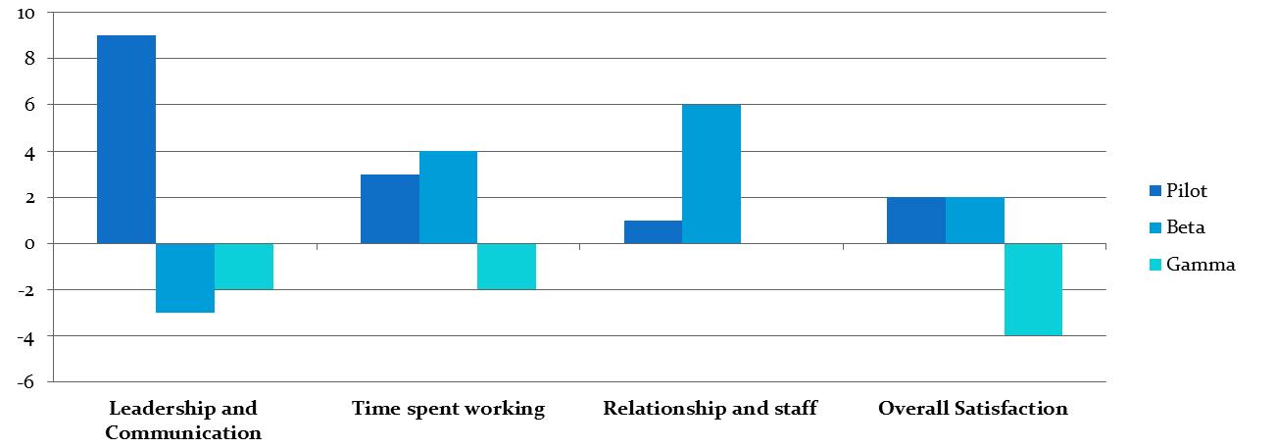
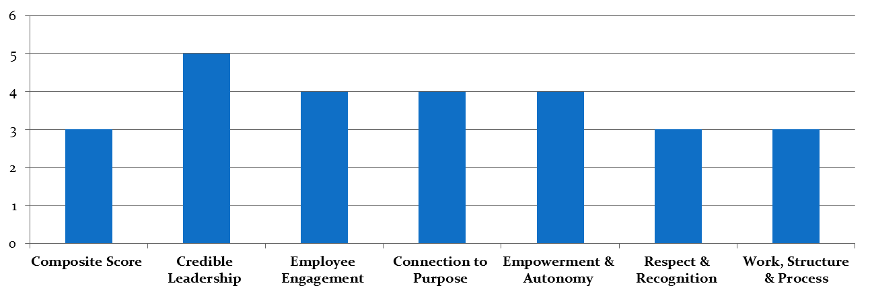
Physician Satisfaction % Differences (2011 vs. 2014)
By phase of implementation
Lean Implementation Phase
Pilot / Model Line
Beta test sites
All remaining clinics
Staff Satisfaction % Differences (2011 vs. 2014)
All primary care clinics system-wide

Slide 26
Summary
Topic | Conclusions
Workflow Efficiency | Increase in timeliness of completing 3 of 4 workflow measures: office visit chart closures, medication renewals, telephone responses.
Physician Productivity | Higher wRVUs generated per physician per month. No change in wRVUs per office visit (service intensity).
Operating Expenses | Lower total operating expenses (including staff compensation, and drugs and supply costs) standardized per tRVU. Not significant at p<0.05.
Clinical Quality | Improvements in coordinated diabetes care metrics, no change in preventive screening metrics, and decreased meningococcal immunization among adolescents.
Patient Satisfaction | Higher satisfaction overall and in specific domains, including access to care and handling of personal issues. Lower satisfaction with interactions with care providers.
Physician Satisfaction | In pilot and beta clinics: Higher satisfaction overall and in specific domains, including time spent working and relationships with staff. Lower satisfaction overall in last phase of gamma clinics to implement Lean.
Staff Satisfaction | Higher satisfaction overall and in specific domains, including credible leadership, employee engagement, growth / development, connection to purpose, healthy partnerships, empowerment and autonomy.
Hung DY, Harrison MI, Martinez MC, Luft HS. Scaling Lean in Primary Care: Impacts on System Performance. American Journal of Managed Care. 2017;23(3):294-301.

Slide 27
Conclusions
Importance of local context
- Successful implementation & outcomes requires:
Engagement of all frontline staff
Alignment with internal clinic environments
Overall, there were beneficial effects of Lean redesigns on performance metrics without harm to clinical quality
Using Lean techniques to redesign care delivery
- Strength of Lean’s attention to “Flow”
- Change management: involve providers and show results
Conclusions
Findings from this study add to a sparse knowledge base as Lean is rapidly being adopted as a vehicle for reducing waste and maximizing value in health care.
Lean redesigns can benefit patients, physicians, and staff without negatively impacting the quality of clinical care.
Satisfaction declines among physicians in gamma sites, who had as few as 4 months of Lean implementation prior to being surveyed, may reflect more recent transitions and also lower engagement.
Our study underscores the need for careful analysis of both desired effects and potential unintended consequences of implementing Lean to improve value in health care.

